Slide 1
Safe real world ADAS testing
Experiences from the UK’s first public road trials.

Slide 2
Safe real world ADAS testing
Experiences from the UK’s first public road trials.

Slide 3
Workshop Agenda
Background for ADAS/AD road testing
What is the law and what guidance is there for undertaking public road testing?
How was this guidance applied on the Highway Pilot?
How is the guidance changing?
What challenges will the industry face in the future with public road testing?

Slide 4
ADAS/AD testing; the status quo?
Testing on ADAS features
Testing of ADAS/AD features a mixture of Simulation, Hardware-in-the-Loop, Track & Public Road testing.
A high proportion of the functional testing can be tested via combination of HIL and track testing.
Testing the extent of robustness of systems requires unique and dynamic scenarios, like those only found whilst undertaking extensive public road testing. Data recorded on extensive public road testing is invaluable, particularly for understanding robustness of autonomous systems when faced with varying weather & road conditions.

Slide 5
Testing on Public Roads
Why test on public roads?
Technical
Scenarios difficult to reproduce on test track / simulation.
Dynamic ‘real life’ scenarios that test capabilities of the system.
Robustness testing providing crucial data to improve through life performance of the system
Non-technical
Demonstration to authorities
To improve public perception and confidence in highly automated vehicles.

Slide 6
Testing on Public Roads
Public Acceptance
Over 50 years since the introduction of the first cruise control. Confidence and public acceptance in ADAS/AD features can take time.

Slide 7
Testing on Public Roads
What’s the law?
Statute
The Road Traffic Act 1988 (RTA)
Road vehicle construction and use regulations 1986
Automated and Electric Vehicle Act 2018 (AEVA)
Guidance
Highway code (CoP, derived from RTA)
The pathway to driverless cars 2015
Code of Practice for Automated Vehicle trialling 2019
Notes:
Automated and Electric Vehicle Act 2018. In particular this makes provision in relation to liability of insurers where automated vehicles cause an accident.
There has been a relatively high level of activity amongst lawyers and academics but it is fair to say that the nature and extent of legal issues is not yet clear.
This is at least in part due to the breadth of the necessary developments. These cover product liability, cyber security, data protection and insurance.

Slide 8
Testing on Public Roads
What’s the law?
Statute
The Road Traffic Act 1988 (RTA)
Road vehicle construction and use regulations 1986
Automated and Electric Vehicle Act 2018 (AEVA)
Guidance
Highway code (CoP, derived from RTA)
The pathway to driverless cars 2015
Code of Practice for Automated Vehicle trialling 2019
Notes:
Code of practice are non-statutory guidelines. Although not law, they could be used as the example of acceptable practice in any litigation that is brought.

Slide 9
Testing on Public Roads
The Pathway to Driverless Cars, 2015
Code of Conduct for autonomous vehicle testing. The primary action of this government report was to first set out a code of practice for undertaking testing on autonomous vehicles. It sets out the governments approach of a ‘a light touch, non-regulatory approach which provides the clarity industry needs to invest in further research and development whilst maintaining safety’. UK government funded projects, three at that time involving autonomous vehicle testing, were required to comply with the code of practice.

Slide 10
Testing on Public Roads
Code of Practice for Automated Vehicle trialling 2019
Updates to the Code of Conduct for autonomous vehicle testing. The updates to the code of conduct published in 2019 were largely focused on emphasis on the existing content, rather than significant changes. The report notes that the public perception of Highly Automated Vehicles is in many ways more critical than the actual technology or processes involved.

Slide 11
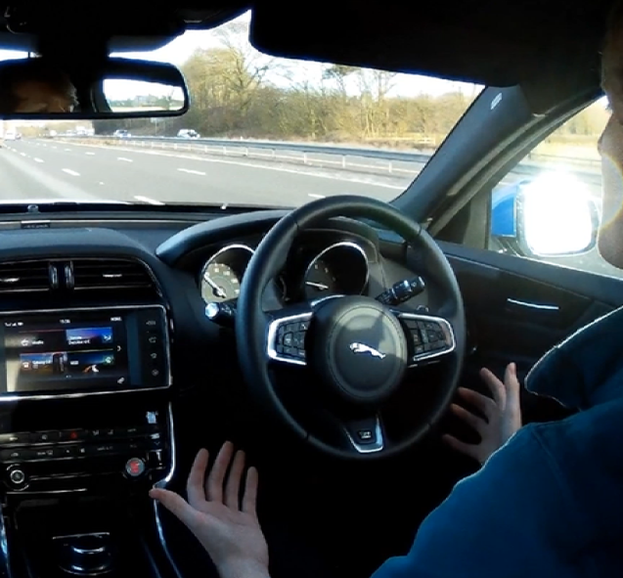
Testing on Public Roads
Key aspects of the code of practice (2015)
Before testing on Public roads, automated features must have been tested on closed roads or test tracks.
Any vehicle tested on public roads requires a driver to be present in the vehicle.
For other areas, a test operator must be present who can apply an emergency stop control from outside the vehicle.
It is recommended that the test driver maintain appropriate eye gaze for normal driving to avoid alarming other road users.

Slide 12
Testing on Public Roads
Key aspects of the code of practice (2015)
Controls must provide clear indication of whether the vehicle is in an manual or an automated mode.
Vehicles will have to have sufficient security to manage the risk of hacking.
Automated vehicles should have a black box data recording device for analysis in the event of an accident.
Software testing must begin with bench testing and simulation before moving to trials on the road. This process should be stated as such and included in the project manual.

Slide 13
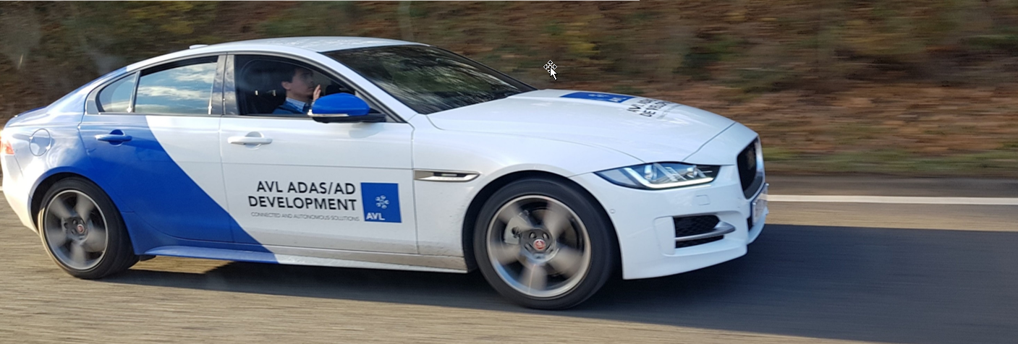
Applying the CoP on Highway Pilot
The Highway Pilot Project
SAE Level 3 Highway Pilot based on AVL functions for:
Autonomous Lane Centering and Lane Change
Adaptive Cruising with Stop & Go
Notes:
Note hands off position here is for photographic purposes only, this is not the recommended practice.

Slide 14
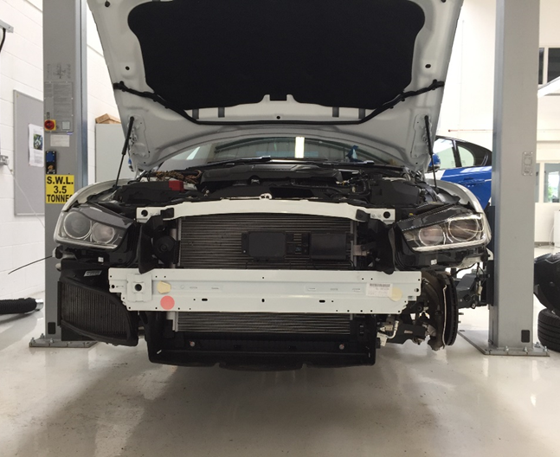
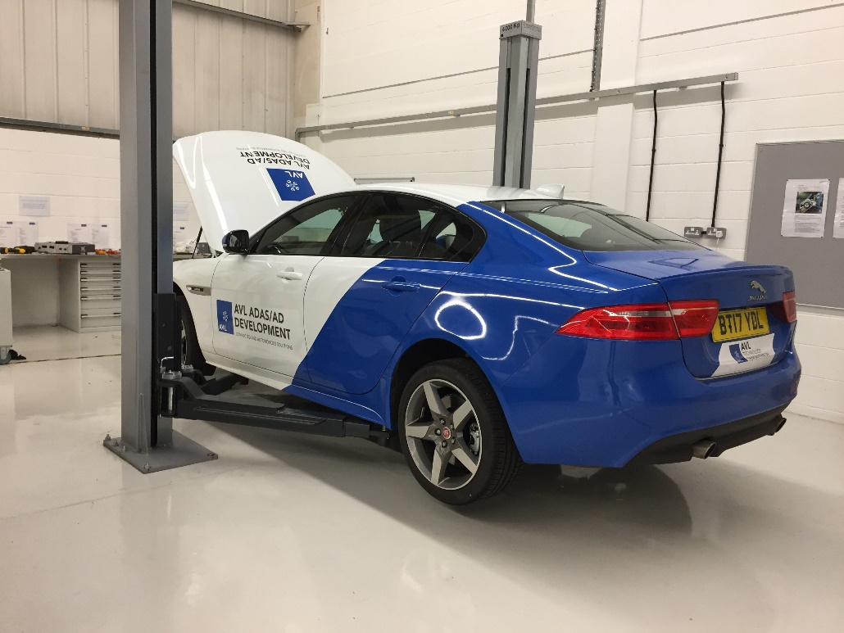
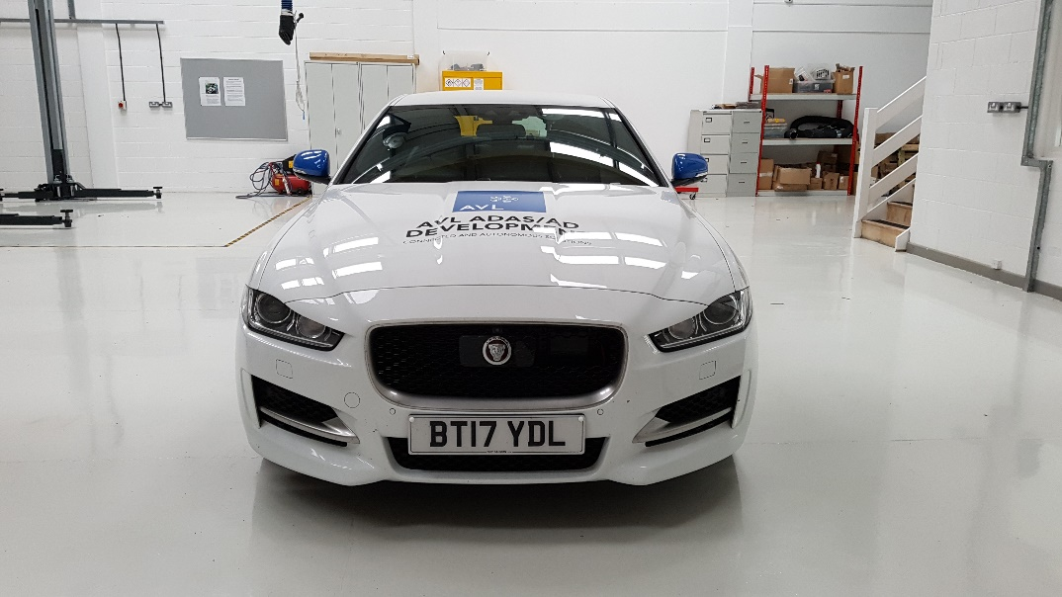
Applying the CoP on Highway Pilot
The Highway Pilot Project

Slide 15
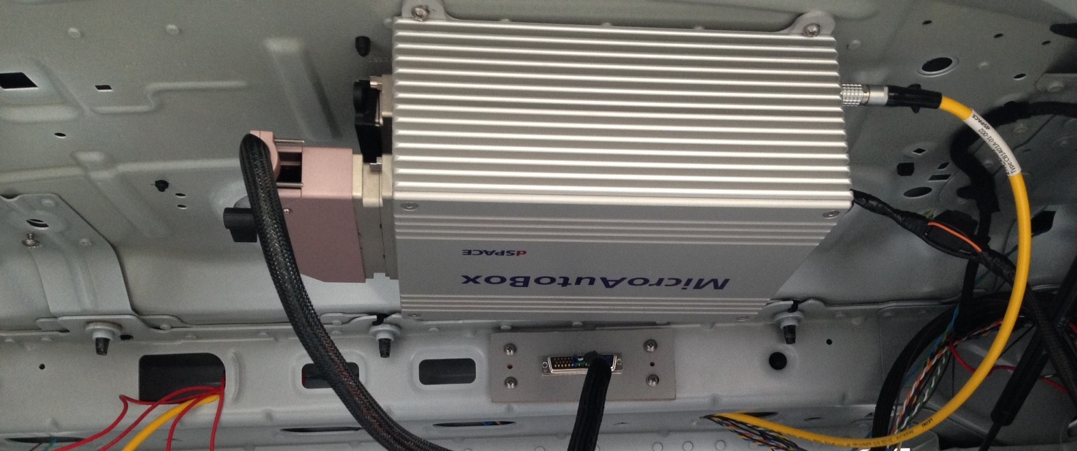
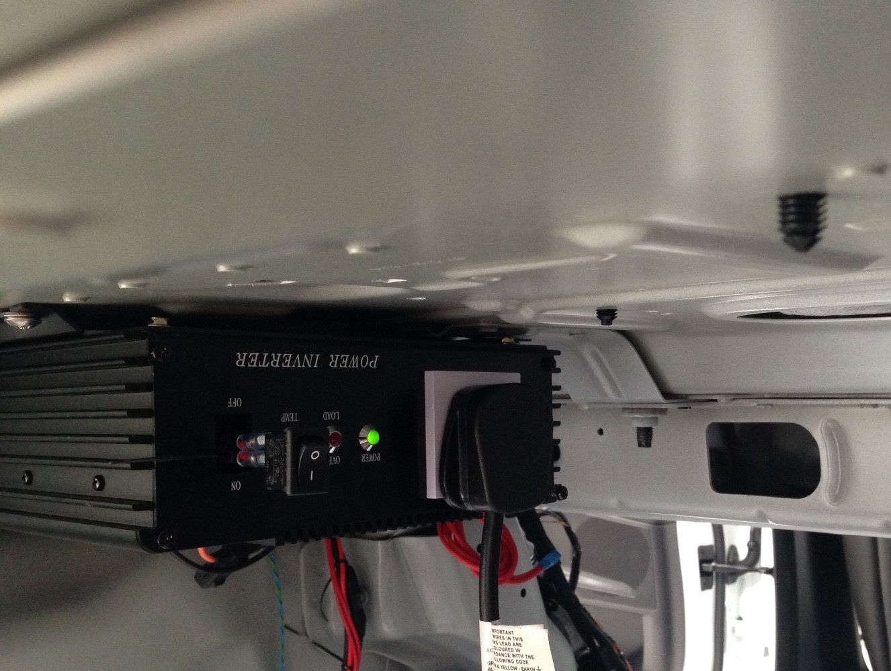
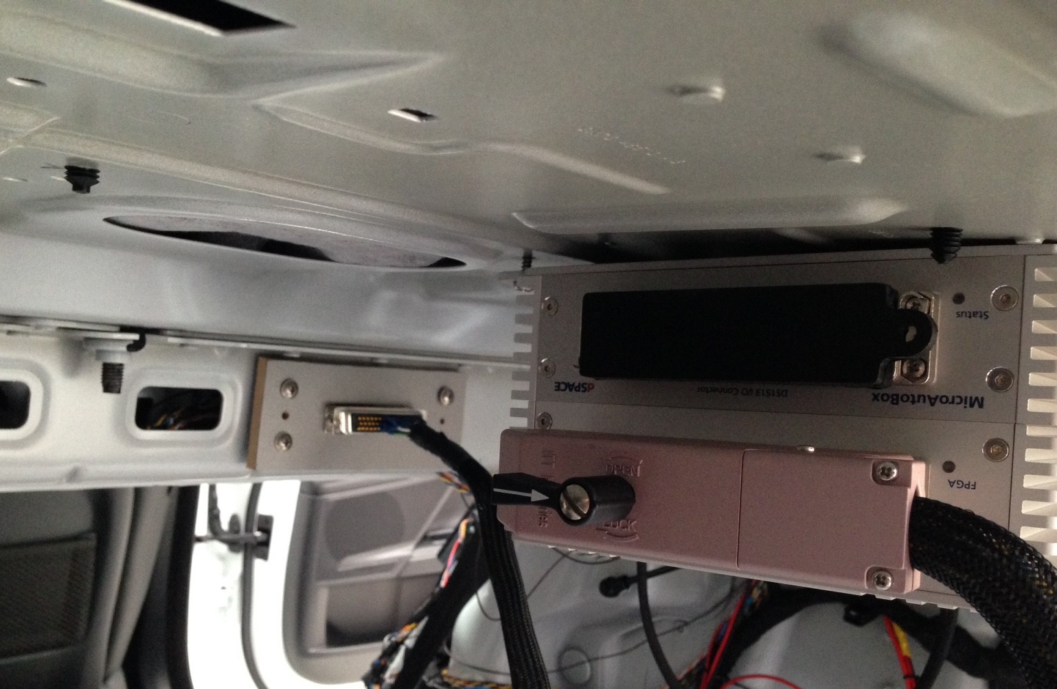
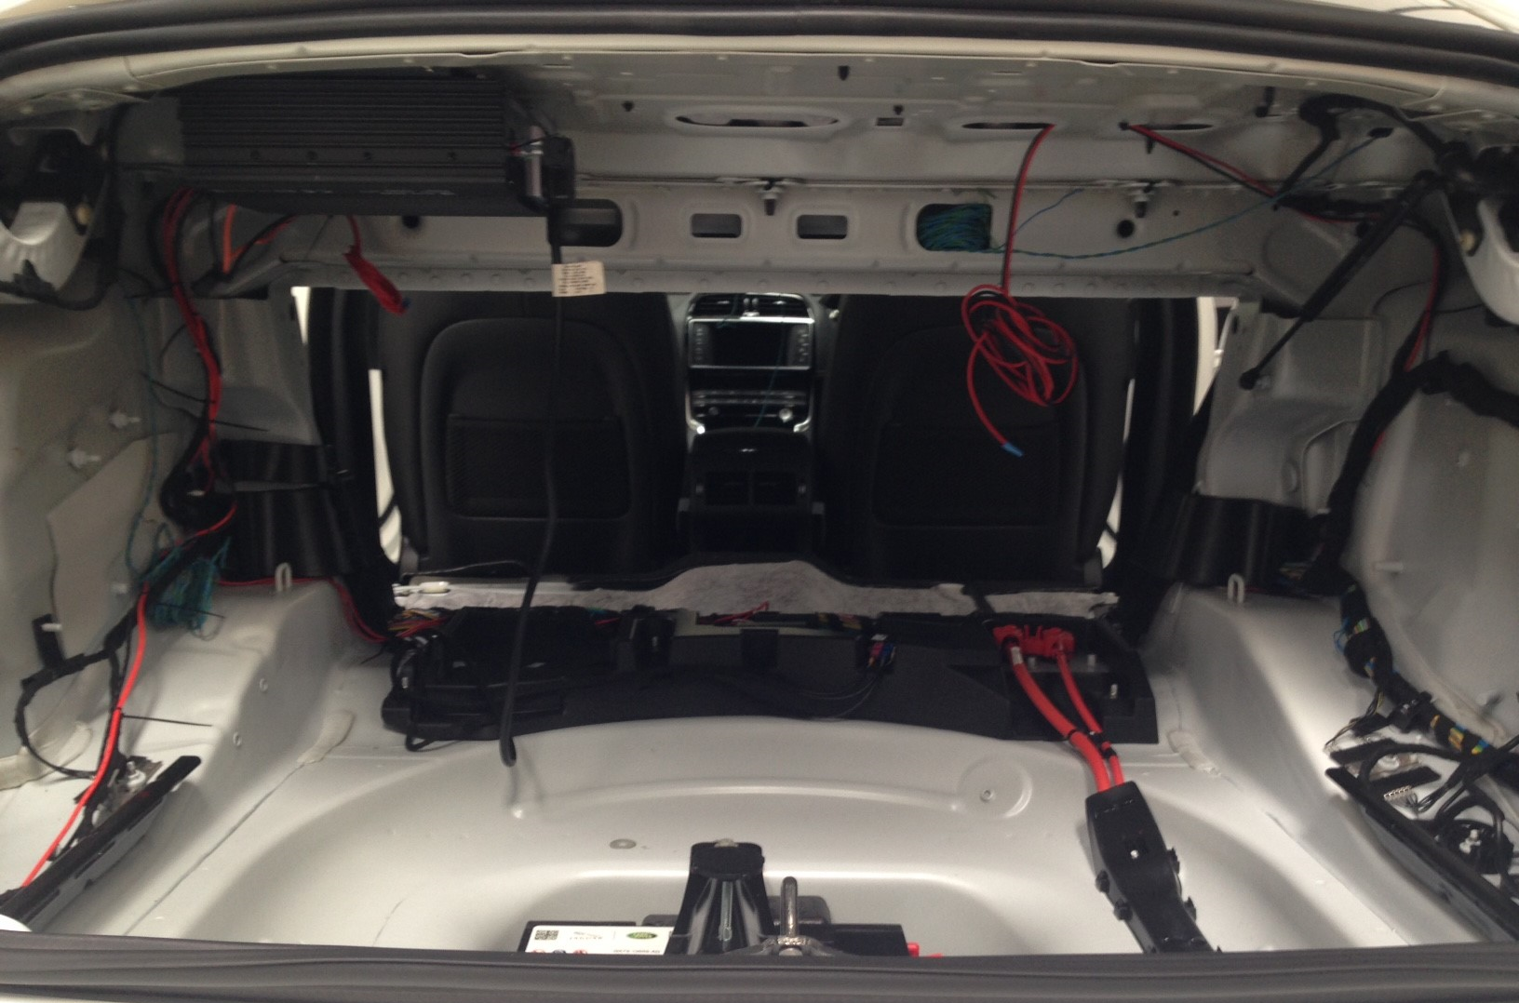
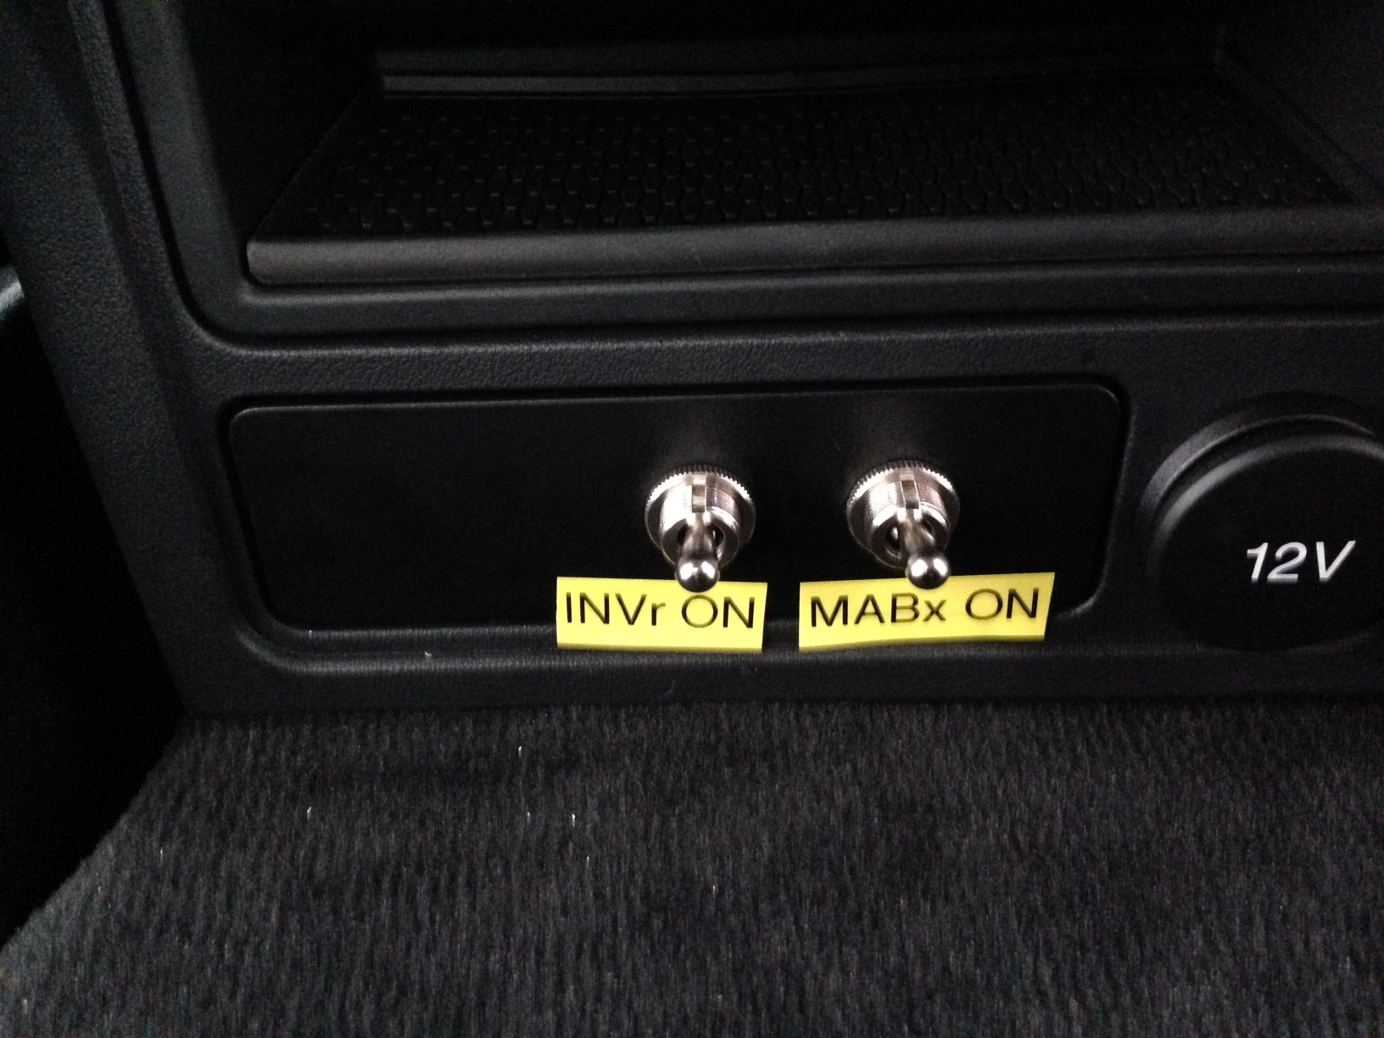
Applying the CoP on Highway Pilot
The Highway Pilot Project

Slide 16
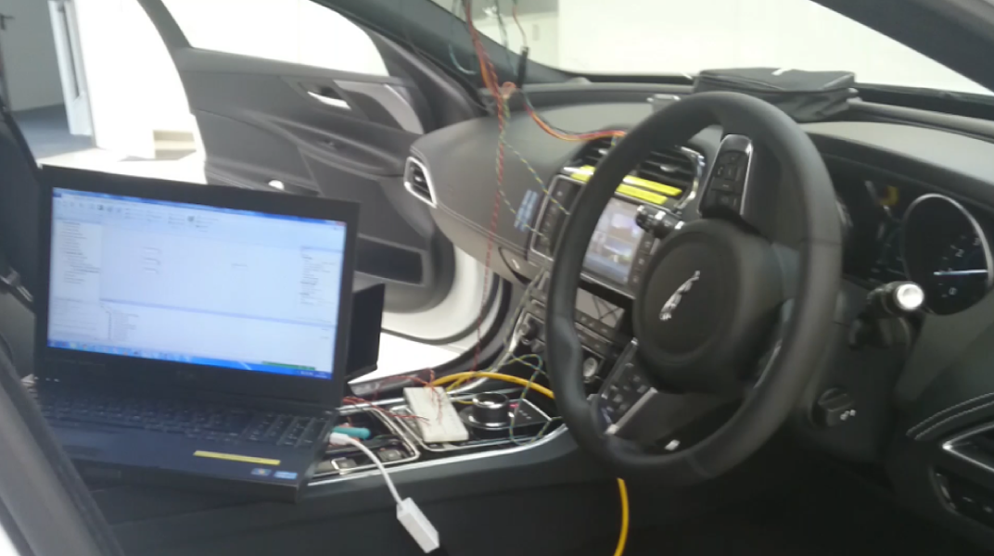
Applying the CoP on Highway Pilot
The Highway Pilot Project

Slide 17
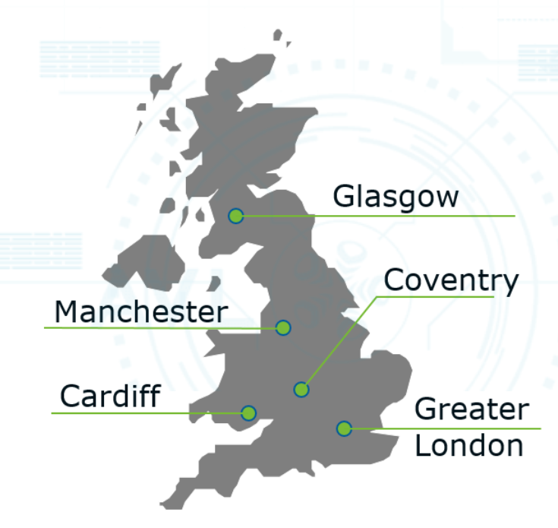
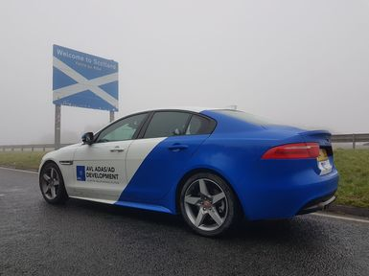
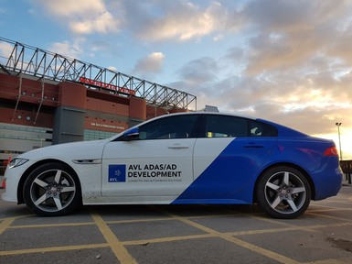
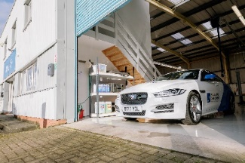
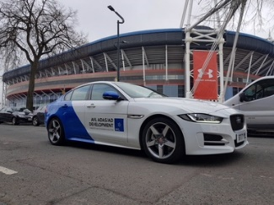
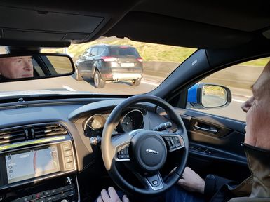
Applying the CoP on Highway Pilot
The Highway Pilot Project
The AVL UK ADAS team completed a GB tour gathering vital engineering data across to fully test the robustness of the functions developed.

Slide 18
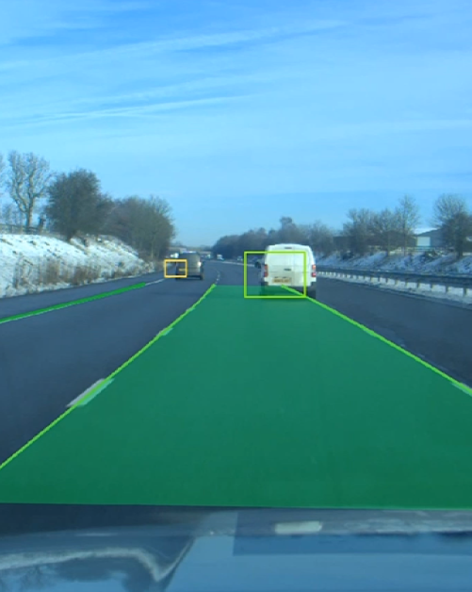
Applying the CoP on Highway Pilot
The process leading to public road testing

Slide 19
Applying the CoP on Highway Pilot
The process leading to public road testing
The key elements of verification and validation followed a process that was compatible with the Code of Practice.
were required to satisfactorily completed before any public road tests were considered and undertaken.

Slide 20
Applying the CoP on Highway Pilot
The process leading to public road testing
The key elements of verification and validation followed a process that was compatible with the Code of Practice.
Simulation undertaken in the office environment first to demonstrate correctly functioning software.
before any public road were considered and undertaken.

Slide 21
Applying the CoP on Highway Pilot
The process leading to public road testing
The key elements of verification and validation followed a process that was compatible with the Code of Practice.
Simulation undertaken in the office environment first to demonstrate correctly functioning software.
Reconnaissance drives to record real life data to be used in further bench tests.

Slide 22
Applying the CoP on Highway Pilot
The process leading to public road testing
The key elements of verification and validation followed a process that was compatible with the Code of Practice.
Simulation undertaken in the office environment first to demonstrate correctly functioning software.
Reconnaissance drives to record real life data to be used in further bench tests.
Testing undertaking on a closed test track for commissioning tests and confidence building.

Slide 23
Applying the CoP on Highway Pilot
The process leading to public road testing
The key elements of verification and validation followed a process that was compatible with the Code of Practice.
Simulation undertaken in the office environment first to demonstrate correctly functioning software.
Reconnaissance drives to record real life data to be used in further bench tests.
Testing undertaking on a closed test track for commissioning tests and confidence building.
Limited public road tests, with perception and control functioning, but no actuation.

Slide 24
Applying the CoP on Highway Pilot
The process leading to public road testing
The key elements of verification and validation followed a process that was compatible with the Code of Practice.
Simulation undertaken in the office environment first to demonstrate correctly functioning software.
Reconnaissance drives to record real life data to be used in further bench tests.
Testing undertaking on a closed test track for commissioning tests and confidence building.
Limited public road tests, with perception and control functioning, but no actuation.
Full public road tests, with an appropriately trained driver with authority and the confidence to override the system immediately.

Slide 25
Applying the CoP on Highway Pilot
Sign off before public road testing
Before undertaking public road tests, AVL UK followed a commissioning process before the team could proceed to public road tests:
Drivers signed to confirm they are suitably trained & have had a through brief on the vehicle/feature.
Full test plan (DVP) completed & signed off by competent and qualified engineer.
Risk assessment up to date and agreed.
Appropriate insurance in place for prototype vehicle
Contact relevant authorities to inform them of the planned tests.
Vehicle inspection & sign off (Road worthy vehicle, appropriate MOT, etc..).
Agreement of feature related restrictions.

Slide 26
Applying the CoP on Highway Pilot
Specific measures to comply with code on conduct
‘…a suitably licensed and trained test driver or test operator should supervise the vehicle at all times and be ready and able to over-ride automated operation if necessary…”
- Pathway to driverless cars, a code of practice. (Department of Transport, 2015)

Slide 27
Applying the CoP on Highway Pilot
Specific measures to comply with code on conduct
‘…a suitably licensed and trained test driver or test operator should supervise the vehicle at all times and be ready and able to over-ride automated operation if necessary…”
- Pathway to driverless cars, a code of practice. (Department of Transport, 2015)
The highway pilot team used enhanced training over the basic requirement:
UK License
Additional advanced driver training (Equivalent to a customer’s internal training).
Specific project based training / induction to the highway pilot vehicle.

Slide 28
Applying the CoP on Highway Pilot
Specific measures to comply with code on conduct
‘…a suitably licensed and trained test driver or test operator should supervise the vehicle at all times and be ready and able to over-ride automated operation if necessary…”
- Pathway to driverless cars, a code of practice. (Department of Transport, 2015)
Mechanisms have to be in place so that the driver can override the system.
Braking, throttle & steering overrides. Will the feature go to standby when the driver intervenes?
Limits on maximum braking, throttle and steering requests. Can the driver intervene quickly enough for an erroneous throttle/brake requests or overpower an erroneous steering request?
E-stop. Can the feature be completely deactivated quickly?

Slide 29
Applying the CoP on Highway Pilot
Specific measures to comply with code on conduct
“The system which is used should: - Be easily and clearly understood by the test driver. - Ensure that the driver is given clear indication of whether the vehicle is in manual or automated mode. - Pathway to driverless cars, a code of practice. (Department of Transport, 2015)

Slide 30
Applying the CoP on Highway Pilot
Specific measures to comply with code on conduct
“The system which is used should: - Be easily and clearly understood by the test driver. - Ensure that the driver is given clear indication of whether the vehicle is in manual or automated mode. - Pathway to driverless cars, a code of practice. (Department of Transport, 2015)
Existing IPC icons were used to indicate to the driver when the Highway Pilot features were activated.

Slide 31
Applying the CoP on Highway Pilot
Specific measures to comply with code on conduct
“Automated vehicles under test should be fitted with a data recording device which is capable of capturing data from the sensor and control systems associated with the automated features as well as other information concerning the vehicle’s movement” - Pathway to driverless cars, a code of practice. (Department of Transport, 2015)

Slide 32
Applying the CoP on Highway Pilot
Specific measures to comply with code on conduct
“Automated vehicles under test should be fitted with a data recording device which is capable of capturing data from the sensor and control systems associated with the automated features as well as other information concerning the vehicle’s movement” - Pathway to driverless cars, a code of practice. (Department of Transport, 2015)
On the highway pilot project, for redundancy two data recording devices were used:
The laptop undertaking the perception function also acted as a recorder for vehicle messaging information and for video.
An additional ‘flight recorder’ style box was also fitted, in the case that the laptop failed to record key information, or was in use by the assistant.

Slide 33
Moving forward
What has changed with the latest Code of Practice?
Requirement of a formal of a safety case, which is required to be published.
Contingency planning with appropriate authorities.
Extensive guidance on engagement with the relevant public bodies, authorities and the wider public. This section also details the minimum engagement required before undertaking any public road trials. (The Annex also provides contact details)
More advice on remote control operation, particularly in understanding risk of latency or communication issues.

Slide 34
Moving forward
What has changed with the latest Code of Practice?
The biggest change is more in emphasis rather than content.
Be seen to be safe, not just be safe.
Developing a dialogue with local authorities well in advance of conducting trials
Communicating to the public
Publishing the safety case
Advertise/market what we’re doing

Slide 35
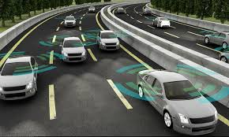
Future Industry Development
Where is the industry moving and what will be the challenges?
Remotely controlled vehicles. Can we ensure that the system can be overridden at any time remotely? Or will we always require a driver in the vehicle?
Vehicle-to-Vehicle communication. Involved risk assessment will have to be undertaken to understand risk to vehicle communication, either through failure of information or from malicious cyber attack.
Connected infrastructure. Similar risks as to connected vehicles. How are these risks understood, assessed and appropriate mitigation put in place?

Slide 36
Future Industry Development
What is AVL Doing?
Midlands Future Mobility Project. A connected autonomous vehicle test bed. Part of the UK Government Funded Research Project, the CAV Test Bed.
AVL UK ADAS/AD Workshop upgrade. The facility in Coventry is being upgraded with facilities appropriate for ADAS/AD vehicle preparation and testing, including:
Electrified vehicle charging
V2x testing
ADAS sensor calibration
CAV vehicle test preparation
Data management infrastructure
Future ADAS/AD vehicle projects. AVL is pursuing multiple research projects, both in highway and urban environments, to expand understanding of the needed development and verification/validation processes, and to explore public perception and acceptance of those advanced technologies.

